Slide 1
This lecture is in-progress
Finalized slides will be uploaded before the lecture

Slide 2

Module Code: SOFT40161 Module Name: Introduction to Computer Programming Lecture 05: Concepts of Object-Oriented Programming (OOP) - Classes, Methods, and Constructors (Week 15:05)
Dan Buxton, MSc, MBCS
Department of Computer Science, NTU
dan.buxton@ntu.ac.uk

Slide 3
Module Contents and Our Plan!
Lecture | Week | Topic | Comment
Lecture 01 | Week 11 | Module Introduction, Programming Basics: Python Environment, Installation, Variables, Data Types and Operations | Done!
Lecture 02 | Week 12 | Procedural Programming: Control Structures with Python (Sequence, Branching, Conditions and Looping) | Done!
Lecture 03 | Week 13 | Data Structures Concepts in Python (Lists, Tuples, Sets and Dictionaries) and Code Quality Considerations | Done!
Lecture 04 | Week 14 | Functions, Modules, Argument Passing, Recursion and Exceptions | Done!
Lecture 05 | Week 15 | Concepts of Object-Oriented Programming (Classes, Methods, and Constructors) | This Week!
Lecture 06 | Week 16 | Working with Data: File I/O and Data Handling and NumPy Operations
Lecture 07 | Week 17 | Data Manipulation with Pandas and Python Libraries
Lecture 08 | Week 18 | Data Visualization: Basic to Customisation
Lecture 09 | Week 19 | Working with Real-World Data, Python for Machine Learning
Lecture 10 | Week 20 | GUI with Python, Coursework, Projects and Review

Slide 4
Learning Outcomes (LO) of this Lecture:
LO-01: Remember Python classes and methods
LO-02: Understand classes, objects, and constructors, including the differences between functions and methods
LO-03: Apply class modelling, including methods and constructors
LO-05: Evaluate when to use OO over procedural programming
LO-04: Analyse problems utilising OO concepts

Slide 5
Roadmap for today
Classes
Dataclasses library
Special methods
Methods and constructor
Inheritance

Slide 6
First exposure to Object Oriented programming (OOP)
Defining functions will only you take you so far.
More complex systems require you to start thing about components and objects.
In real-life we think about things in terms of objects.
For example, when you think about a table, we tend to break it down into its component blocks.
A table is made out of four tables legs and a table top.
Object-oriented programming can be thought about in the same terms whereby smaller units (objects) are used to describe its behaviour (functions) and state (data).

Slide 7
What is a class?
A class is a contract that describes a physical object or entity. Like a function, a class can be reused, or instantiated many times. We have used classes before, str and int types are both classes.
Modular Design: Breaks down complex programs into objects
Code Reusability: Write once, use multiple times
Abstraction: Hides complex definitions, simplifies code usage
Encapsulation: Protects internal code, exposes only what's necessary
Maintainability: Easier debugging and code updates

Slide 8
Why use classes?
Avoid Redundancy: Eliminate code duplication
Simplify Code: Improves readability and structure
Enhance Testing: Isolate components for easier debugging
Scalability: Allows code to grow more efficiently
Collaboration: Promotes teamwork and modular development

Slide 9
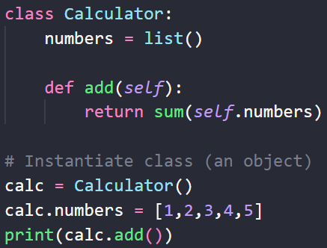
Basic Class?
A class allows us to break our program down into smaller re-usable contracts. We have been using classes in our programs so far (int, str, list, etc…) – these are all classes. A class is structured as follows:
class <class name>:
<fields/properties>
[<methods>]

Slide 10
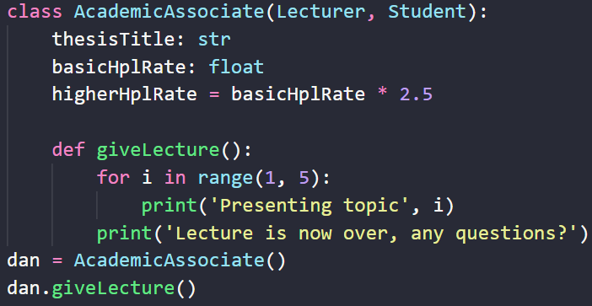
Syntax and Definition
Classes have a signature:
class <class name> [ (<base class>[,<base class>]*) ]:
The signature is made up of:
Class name
Base class
Base classes are optional. We’ll go into more detail later - inheritance
Example
Base classes

Slide 11
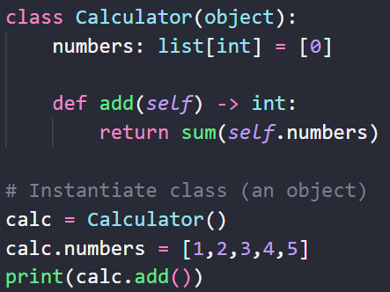
Defining variable/return types?

Slide 12
The Problem
We have a program that asks the user for a person’s name and age.
We have multiple approaches
Procedural - including loops
Functional
Object-Oriented

Slide 13
What we have done so far
Procedural programming
Functional programming
p1Name = input('Enter name: ')
p1Age = int(input('Enter age: '))
p2Name = input('Enter name: ')
p2Age = int(input('Enter age: '))
def getPersonDetails():
name = input('Enter name: ')
age = int(input('Enter age: '))
return name, age
p1Name, p1Age = getPersonDetails()
p2Name, p2Age = getPersonDetails()

Slide 14
The OOP Approach
class Person:
name: str
age: int
p1 = getPersonDetails()
print(p1.name, p1.age)
p2 = getPersonDetails()
print(p2.name, p2.age)
def getPersonDetails():
p = Person()
p.name = input('Enter name: ')
p.age = int(input('Enter age: '))
return p

Slide 15
What are class methods?
Class methods are functions that mimic a physical object’s or an entity’s behaviours or actions. Like a function, they can be defined once and reused many times. We have used class methods before: str.join() and list.split().
Modular Design: Breaks down complex programs into objects
Code Reusability: Write once, use multiple times
Abstraction: Hides complex definitions, simplifies code usage
Encapsulation: Protects internal code, exposes only what's necessary
Maintainability: Easier debugging and code updates

Slide 16
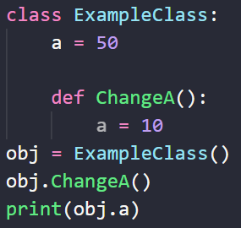
Variable Scope (last week)
Variable scope dictates where it can be seen and not be seen.
i.e. can the variable be accessible within the current code block?
class ExampleClass:
a = 5
def changeA():
a = 10
e = ExampleClass(); e.changeA()
The value is = 5 or 10?

Slide 17
Variable Scope (solved)
Variable scope dictates where it can be seen and not be seen.
i.e. can the variable be accessible within the current code block?
class ExampleClass:
a = 5
def changeA(self):
self.a = 10
e = ExampleClass(); e.changeA()
The value is = 5 or 10?
Magic parameter
- self

Slide 18
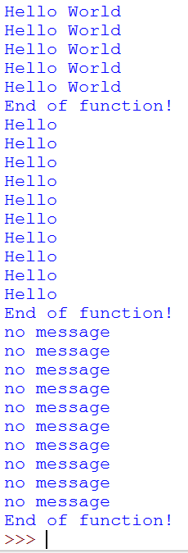
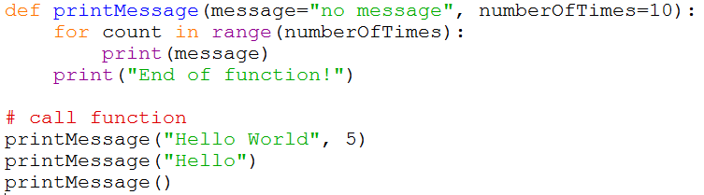
Parameters - Defaults
Function parameters can also have default values associated with them so that if they are not passed in, the default is used instead.

Slide 19
Calling Functions and Argument Passing
Case 01
Case 02
Case 03
Case 04
Called Function
Called Function
Called Function
Called Function
No Return Value
Some Return Values
No Return Value
Some Return Values
No Mess-age Value
No Mess-age Value
Some Mess-age Value
Some Mess-age Value
Calling Function
Calling Function
Calling Function
Calling Function

Slide 20
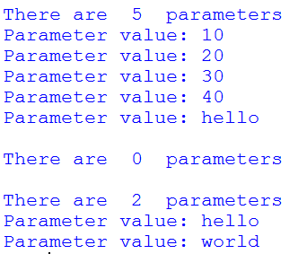
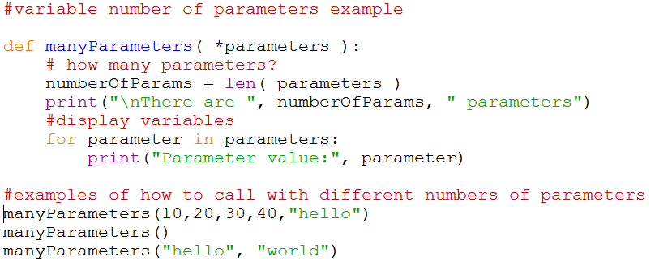
Variable number of parameters
So far, functions can have an explicitly defined number of parameters.
What if we don’t know how many parameters to expect? (e.g. print)
In the parameter list, use * followed by a parameter name.

Slide 21

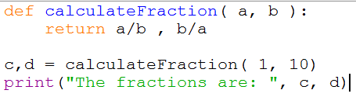
Returning Values
Functions can return information which has been created or manipulated within the function using the return keyword.
You can also return more than one value by using commas.

Slide 22
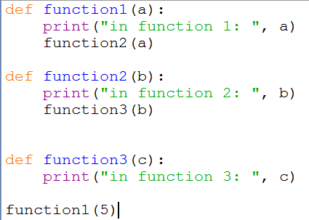
The Stack – Calling Functions
The stack stores temporary data in relation to a function:
Function call details including parameters
Local variables
Return addresses
Function3
Parameters(s): c
Local variables
Return address
Function2
Parameters(s): b
Local variables
Return address
Program Stack
Function1
Parameters(s): a
Local variables
Return address

Slide 23
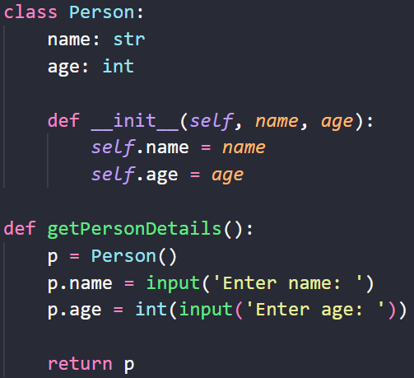
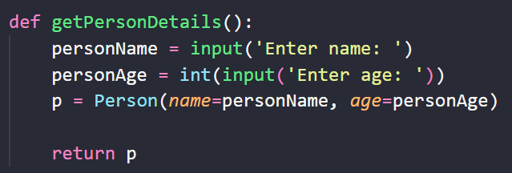
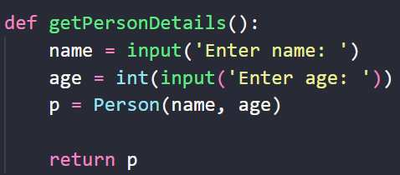
Constructor – Special method

Slide 24
More special methods
__eq( obj )__
Change the compare functionality when using obj1 == obj2
__str( obj )__
Printing obj1 will print the class type and the memory address. Implement this class method and you can change the string representation of object

Slide 25
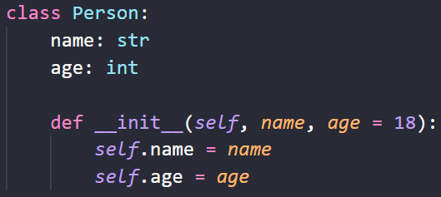
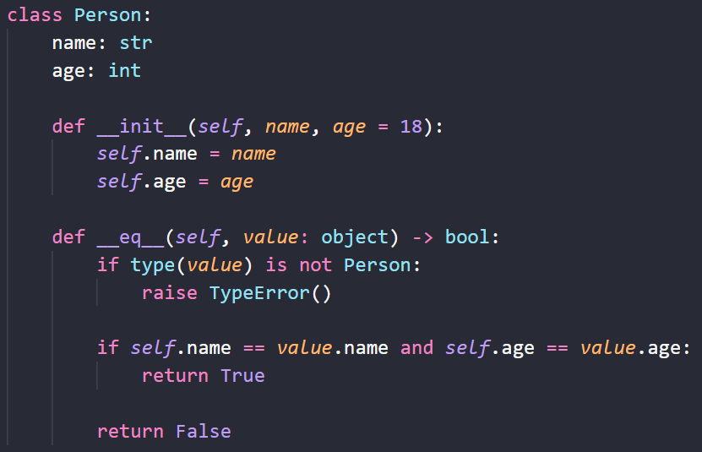
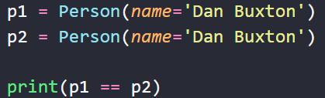
Comparing objects

Slide 26
Dataclasses library

Slide 27
Core OOP concepts
Inheritance
Polymorphism

Slide 28
What is Inheritance?
Inheritance is a process of expanding a previous contract into a new one without changing it.
Modular Design: Breaks down complex programs into objects
Code Reusability: Write once, use multiple times
Abstraction: Hides complex definitions, simplifies code usage
Encapsulation: Protects internal code, exposes only what's necessary
Maintainability: Easier debugging and code updates

Slide 29
Why use Inheritance?
Avoid Redundancy: Eliminate code duplication
Simplify Code: Improves readability and structure
Enhance Testing: Isolate components for easier debugging
Scalability: Allows code to grow more efficiently
Collaboration: Promotes teamwork and modular development

Slide 30
Inheritance visualized
Person
Name, Age
Name, Age
EmployeeNumber
Employee
Student
Name, Age
StudentNumber,
ModulesLearning
Name, Age,
EmployeeNumber
ModulesTeaching
Lecturer
Name, Age,
EmployeeNumber, ModulesTeaching,
StudentNumber, ModulesLearning
ThesisTitle
Academic Associate

Slide 31
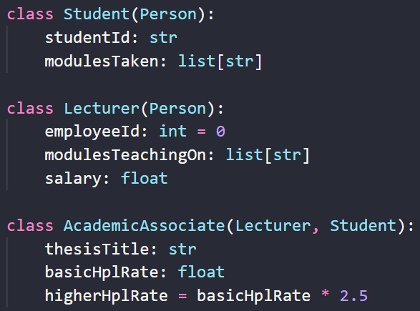
Inheritance example

Slide 32
What is Polymorphism?
Polymorphism is a process of using an object as its base class.
Modular Design: Breaks down complex programs into objects
Code Reusability: Write once, use multiple times
Abstraction: Hides complex definitions, simplifies code usage
Encapsulation: Protects internal code, exposes only what's necessary
Maintainability: Easier debugging and code updates

Slide 33
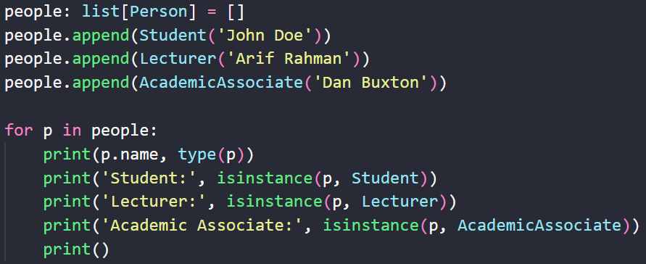
Polymorphism example
Person
Lecturer
Student
Academic Associate

Slide 34
Exposure to persisting data
Using objects and volatile storage will only you take you so far.
More complex systems require you to think about storing data you collect.
In real-life, think in terms of the university.
For example, when you enrol, you do it once a year, not every class you attend.
This information is stored in a non-volatile platform, a database.
Beginning with databases can be confusing, another example are files.
We will look at this next week.

Slide 35
Summary
How to create and instantiate a class
Data fields and methods
Next time, using files…
Special methods, inc. constructor
Inheritance

Slide 36
Directed Study
Revisit past code examples and re-develop them using classes and methods with return values
Advanced tasks:
check out https://www.oodesign.com/
Read chapters 6 & 7
References:
[1] Sommerville, I., Software Engineering, 10th Edition (Global), Pearson, 2016

Slide 37


